Slide 1
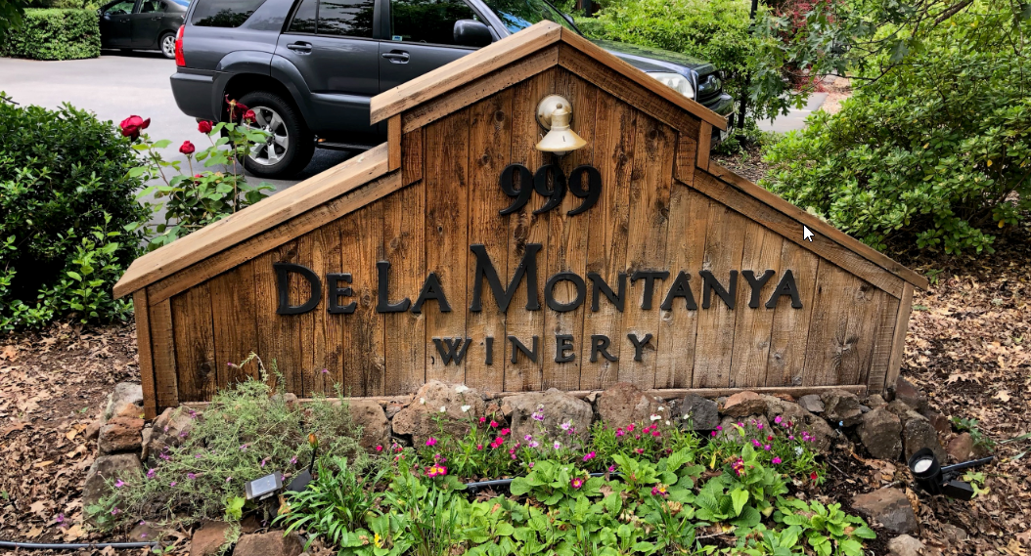
Washoe County Board of Adjustment
September 5 , 2019
Administrative Permit Case Number: WADMIN19-0014 (De La Montanya Winery)

Slide 2
Case Description
Administrative permit for a winery use in the Low Density Suburban Regulatory Zone
4,199 sq ft building
  Production area is 1,170 sq ft
  Tasting and barrel rooms will be 2,400 sq ft total
Located off of Bordeaux Drive
2 acres in size – 1 acre vineyards
No Special Events (Weddings, etc) allowed

Slide 3
Background
16 parking spaces proposed
    WCC Section 410 requires a minimum of 5 parking spaces
The site is served by municipal water (TMWA) and sewer (Washoe County)
Trip generation is expected to be around 30 ADT
4 full time personnel
This property had CC&R’s established in 1964. The adjacent property owners under the CC&R’s rescinded the CC&R’s in May of 2019

Slide 4
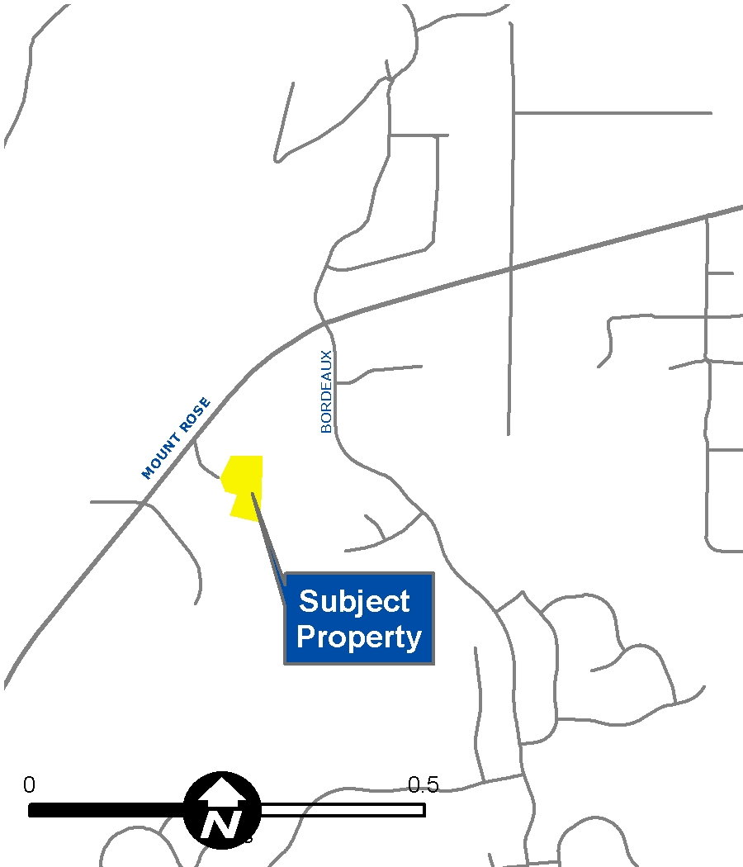
Vicinity Map

Slide 5
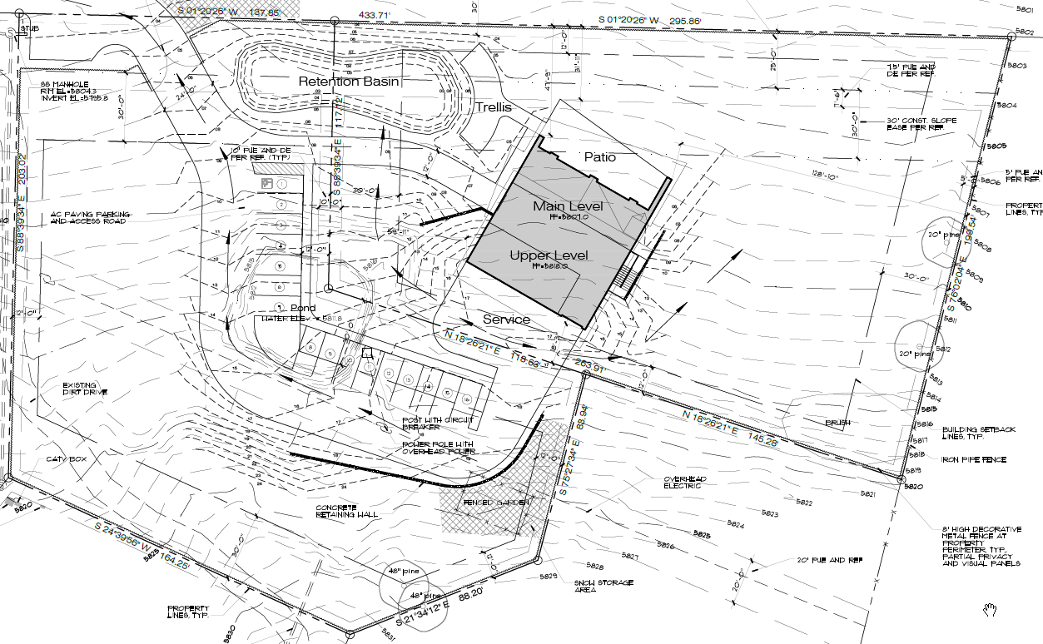
Site Plan

Slide 6
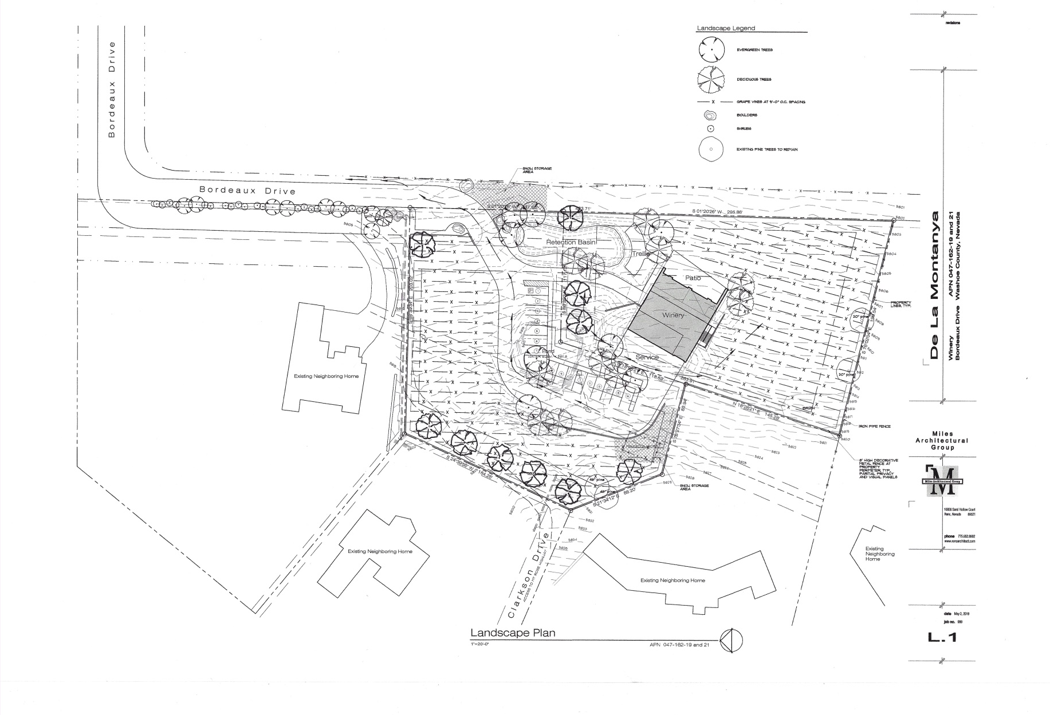
Updated Landscape Plan

Slide 7
Public Input Aug. 1- Sept. 4, 2019
7 phone calls to the Planning Department voicing opposition to the proposal
  Concerns were largely traffic related and school children (bus stop) related
Received 20 emails in opposition
Received 3 emails in support

Slide 8
Public Input Aug. 1 – Sept 4, 2019
Significant concern related to this venture being a “stake in the ground” designed to open up the surrounding land to commercial developments of all sorts

Slide 9
Washoe County School Bus Stop
Bus 1620
Pick up is at 9:03 AM
Drop off is at 3:54 PM
25 Students utilize this stop

Slide 10
Director’s Modification
The applicant submitted a Director’s Modification application on August 8, 2019 to modify the buffer requirements, tree requirements, and the fencing requirements as is required from WCC 110.412.40 (c) and WCC 110.412.40(d).

Slide 11
Conditions of Approval
The Director’s Modification application was reviewed by staff and the following conditions were provided within Exhibit A.
  No Landscaping buffer will be required, the vineyards are living cover and satisfy the landscaping buffer requirements. Staff will require ornamental landscaping around the parking areas, entry to the property, and around the primary structure. (Condition 1i)
  No trees will be required every twenty linear feet of property frontage. Instead staff is requiring the densification of trees near the primary structure, parking areas, and entry to the property. (Condition 1h)
  The addition of smooth wire fencing and transparent predator resistance fencing is supported and has been added to the conditions of approval. (Condition 1g)

Slide 12
Conditions of Approval
1j - Agricultural machinery and tools shall be screened from adjacent properties when not in use.
1l - Prior to Certificate of Occupancy, the owner shall install signage at the exit of the driveway indicating the presence of a school bus drop off zone and children present.
1m - Prior to Certificate of Occupancy, the owner shall work with Washoe County Engineering and Public Works to appropriately sign the section of Bordeaux Drive and the entrance of the project with appropriate signage. If Washoe County Engineering deems this condition unnecessary this condition shall not be enforced.

Slide 13
Conditions of Approval
1n - The owner(s) of APNs 047-162-19 and 047-162-21, along with its successors and assignees, shall be responsible for the maintenance, in perpetuity, of roadway as described in Washoe County Recorder’s Document Number 1926933, with the following exception of the easement area being south of the access driveway to APN 047-162-21. Should an additional ingress/egress driveway or other vehicular access, for purposes of serving either portion of APNs 047-162-19 and 047-162-21 be established within the easement described in Doc # 1926933, the maintenance and improved pavement sections shall be extended to the southern edge of that vehicular access. The agreement shall be executed between the owners of APNs 047-162-19 and APNs 047-162-21 (currently “Dennis and Tina De La Montanya Trust”) and the Montreux Development Group LLC. A separate maintenance agreement shall be drafted between the “Dennis and Tina De La Montanya Trust” and surrounding property owners who use the road for access.
    1 o (vii) - The owner shall limit hours of operation to “by appointment only” on Monday - Thursday and shall limit appointments between 2:30 P.M. - 4:30 P.M.

Slide 14
Recommendation
Those agencies which reviewed the application either made no comments or recommended conditions in support of approval of the project. Therefore, after a thorough analysis and review, Administrative Permit Case Number WADMIN19-0014 is being recommended for approval with conditions.

Slide 15
Motion
I move that, after giving reasoned consideration to the information contained in the staff report and information received during the public hearing, the Board of Adjustment approve Administrative Permit Case Number WADMIN19-0014 for De La Montanya Winery, having made all five findings in accordance with Washoe County Development Code Section 110.808.25

